Slide 1
About Us
Services
Clients Stories
Resources
Contact
一级
Accounting
二级
Tax
Financial Management

Slide 2
About Us(主要是图文就好）风格和整体一致就好。
https://www.mdastudio.co.nz/?gclid=EAIaIQobChMIjbe1zNuY8AIV1jMrCh3diQDEEAAYAiAAEgILbPD_BwE
Accounting
Tax
Financial Management
页面模仿
https://sba.co.nz/our-services/monthly-accounting/
https://sba.co.nz/our-services/annual-accounting/

Slide 3
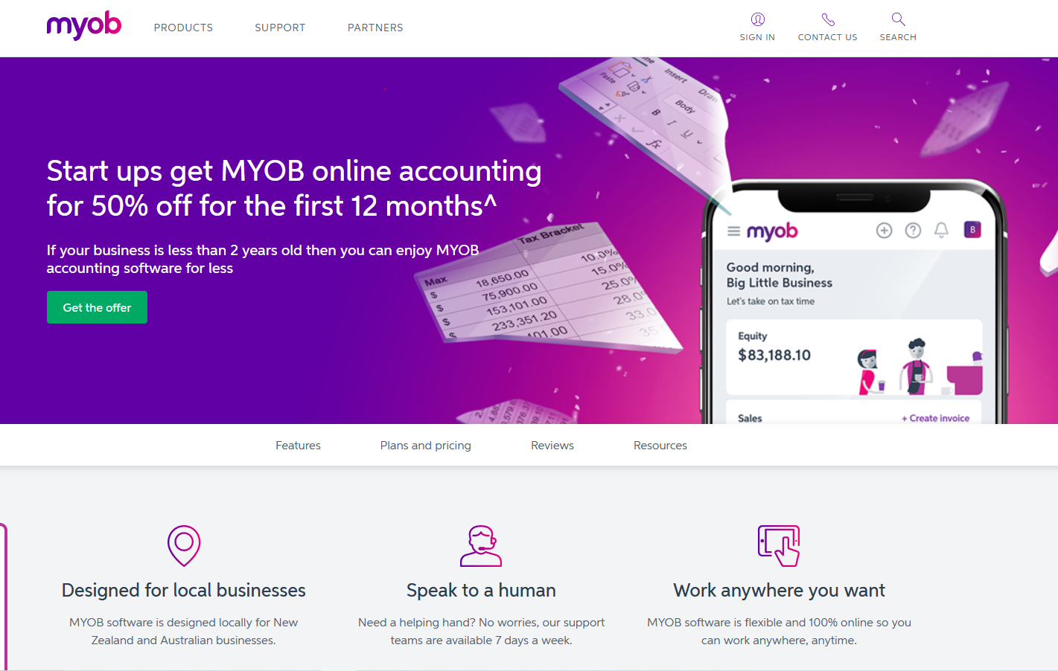
Packages
模仿
https://www.myob.com/nz/small-business/start-ups-offer?gclid=EAIaIQobChMI-uzJ0NGY8AIVcpzCCh29FgXfEAAYASAAEgJgivD_BwE&gclsrc=aw.ds
1.Packages
2.Payroll
3.Company registration consultancy
4.Xero

Slide 4
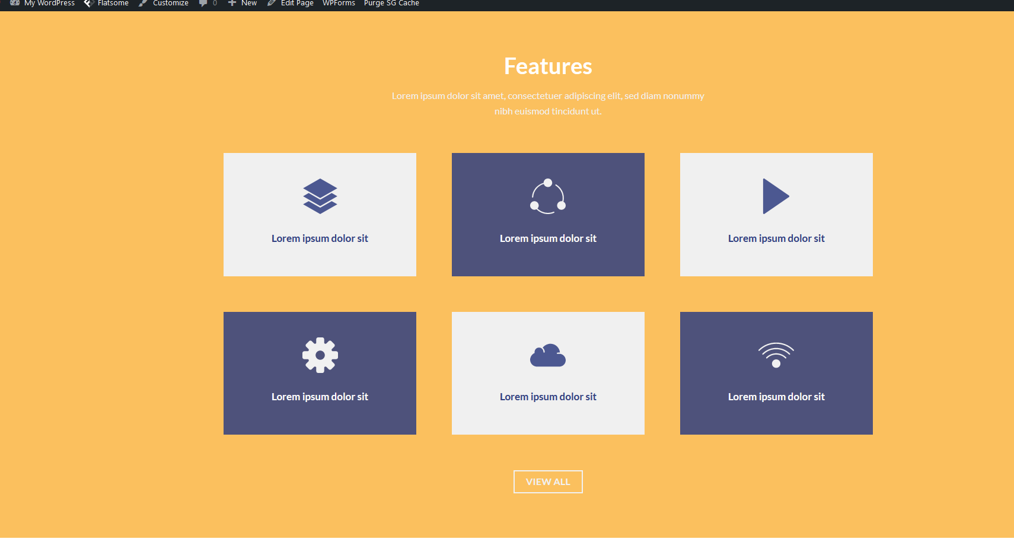

Resources：（保持现在改好的样式，和别的页面风格统一一下）
点击下载文件
跳转到别的网站

Slide 5
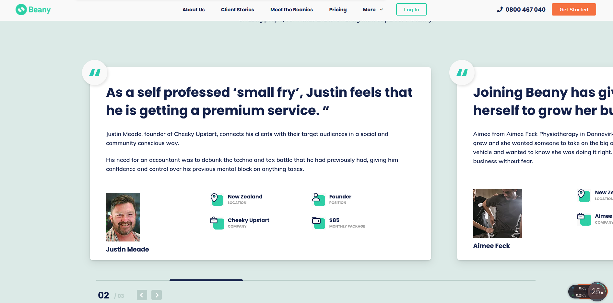
Clients Stories
模仿
https://www.beany.com/client-stories/

Slide 6
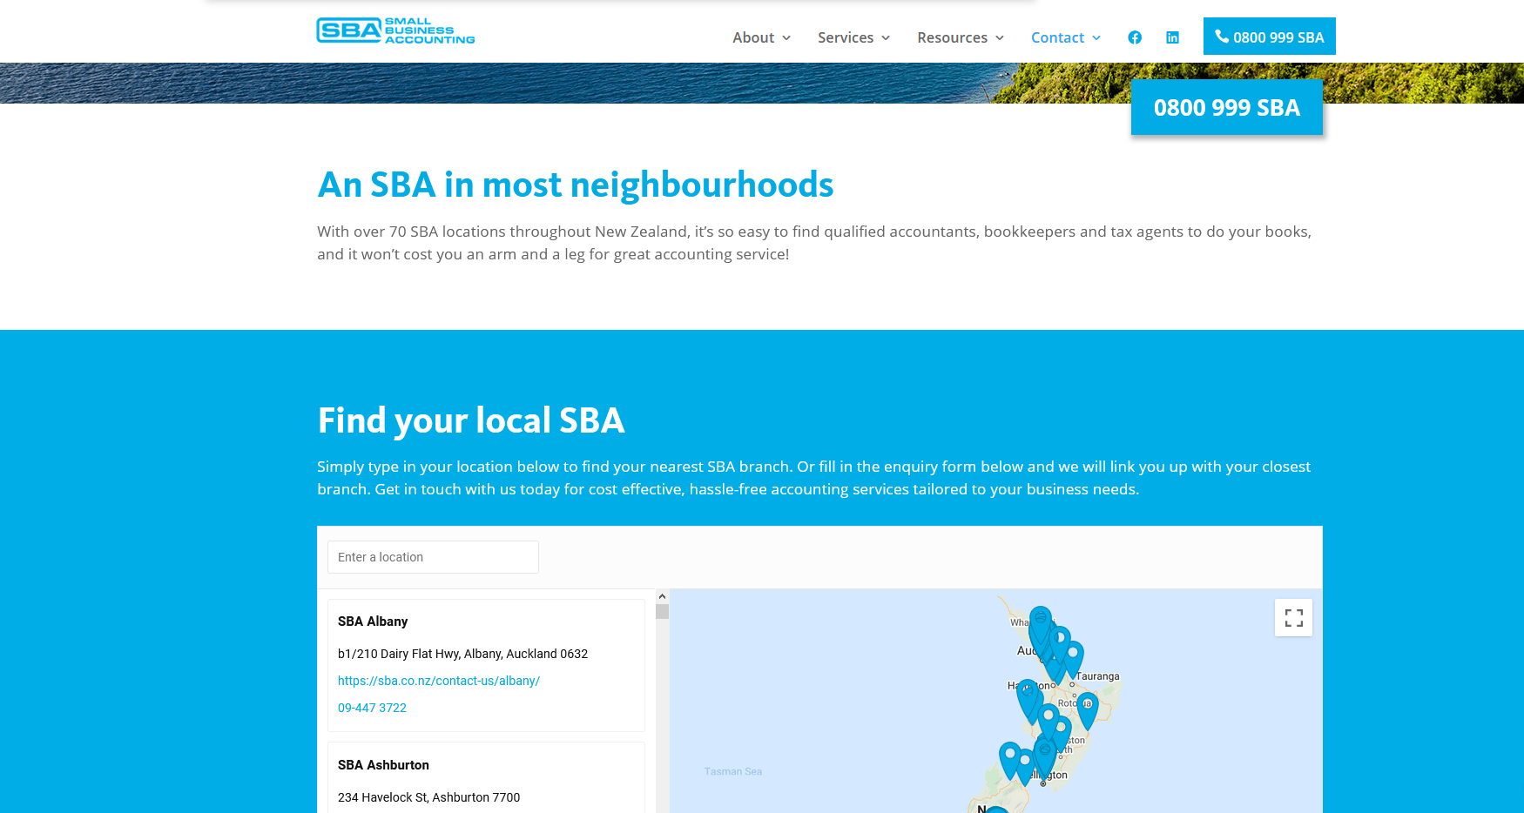
Clients Stories
模仿
https://sba.co.nz/contact-us/

